Slide 1
Lesson plan
Starter – Ethical question ‘should x be saved by this therapy’
Main
Use the big picture magazine
Plenary
Agree and disagree statements

Slide 2
My sisters keeper trailer
https://www.youtube.com/watch?v=HP4NxUFgFrs

Slide 3
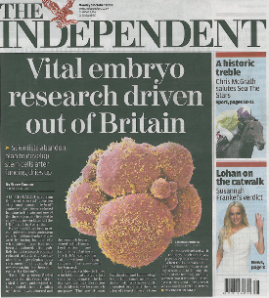
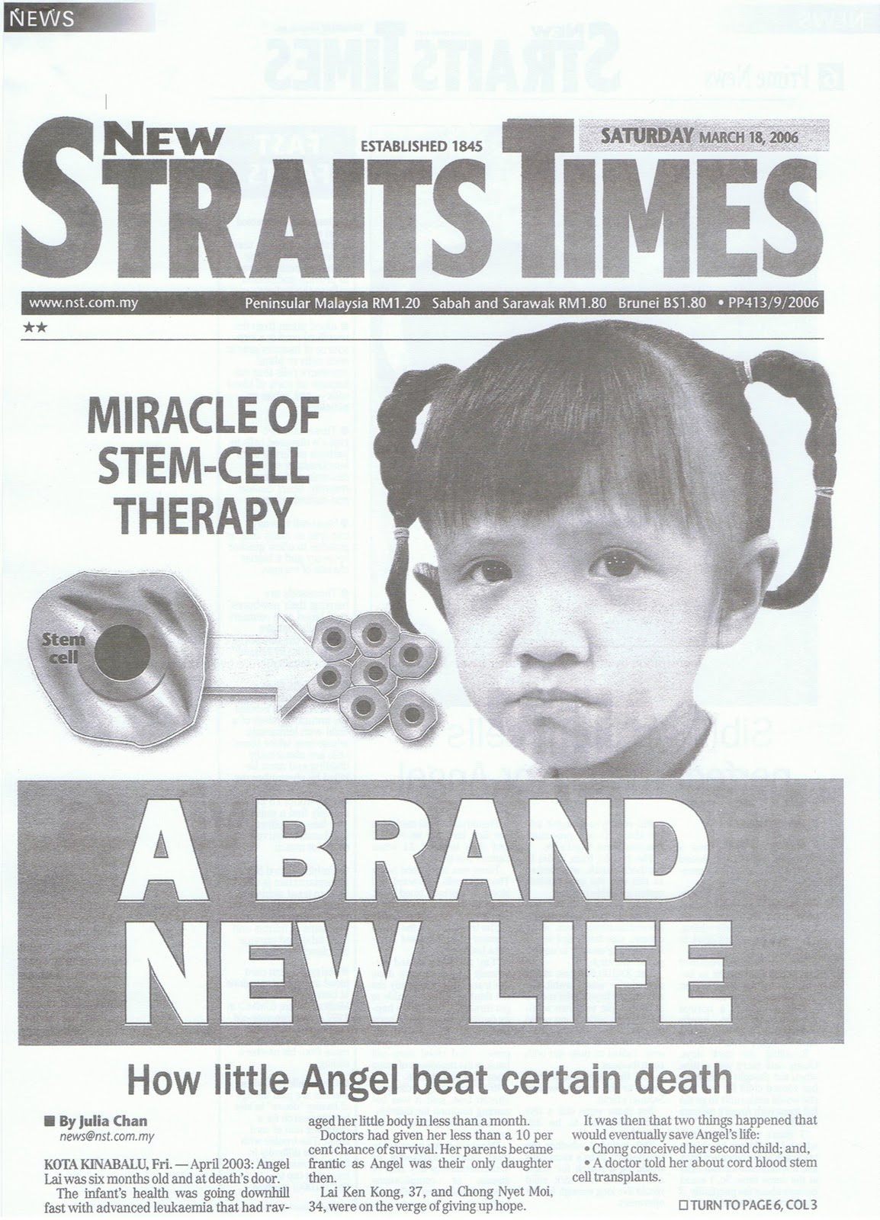
Starter
Do you believe human embryos should be harvested for stem cell research?

Slide 4
Curriculum link: 1.1 Cell biology.
Ethical implications of research – research involving stem cells is growing in importance and raises ethical issues.
Lesson Objectives
Describe what stem cells are and where they are found
Describe the role of stem cells in embryonic development
Evaluate the ethical questions that raise from the use of stem cells

Slide 5
Key notes
Inside each nucleus of every cell in your body is the blue prints to clone you.
However cells become differentiated and only express some genes and not others in a cell’s genome.
Stem cells are undifferentiated and this gives them the ability to be used to as replacement for many different types of cells that have been lost or damaged.
Human stem cells are found in human embryos and some adult tissues like bone marrow.
If they can be harvested, they can be used in other parts of the body to regenerate damaged tissues.

Slide 6
Some animals are able to re-grow parts of their bodies…

Slide 8
But most are not ☹

Slide 9
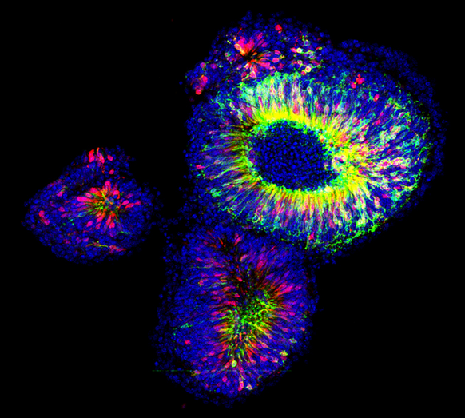
Stem Cells
A cluster of nascent retinae generated from 3D embryonic stem cell cultures, by UCL News on Flickr (CC): http://flic.kr/p/ffPBPT

Slide 10
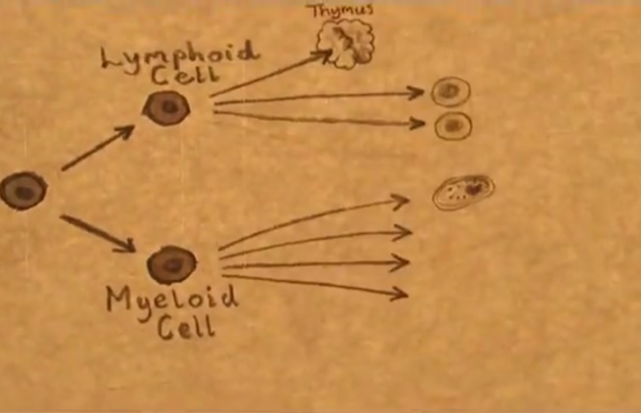
A Stem Cell Story http://www.youtube.com/watch?v=2-3J6JGN-_Y

Slide 11
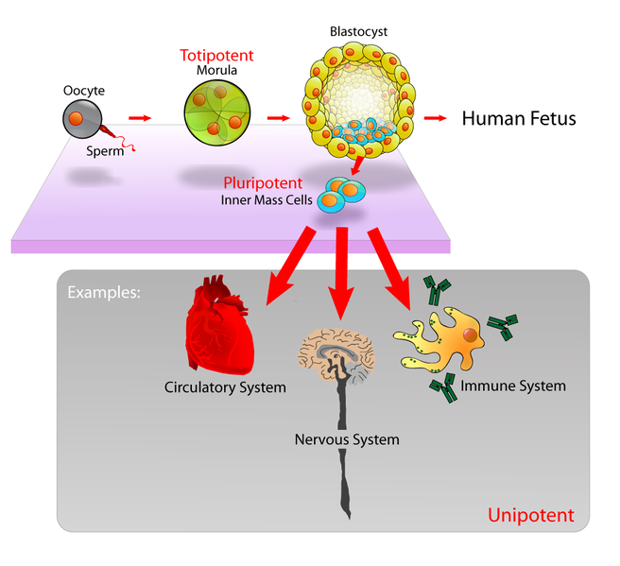
Stem Cells retain the capacity to divide and can differentiate along divergent pathways.
Totipotent
Can differentiate into any type of cell.
Pluripotent
Can differentiate into many
types of cell.
Multipotent
Can differentiate into a few closely-related types of cell.
Unipotent
Can regenerate but can only differentiate into their associated cell type
(e.g. liver stem cells can only make liver cells).
Image from: http://en.wikipedia.org/wiki/Stem_cell

Slide 12
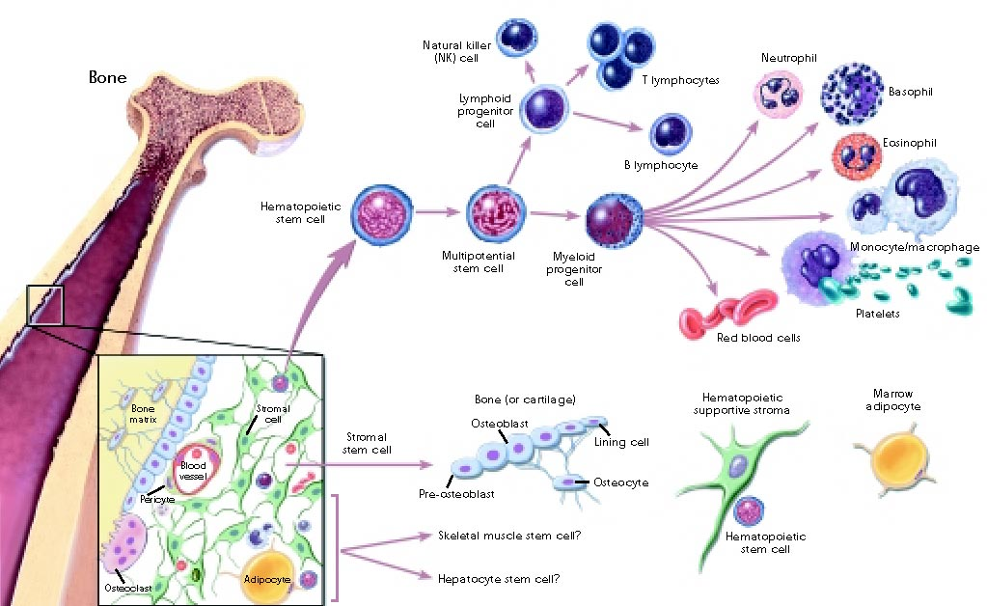
Stem Cells retain the capacity to divide and can differentiate along divergent pathways.
By Fwfu at en.wikibooks [Public domain], from Wikimedia Commons
http://commons.wikimedia.org/wiki/File%3AStemcelldifferentiaion.jpg

Slide 13
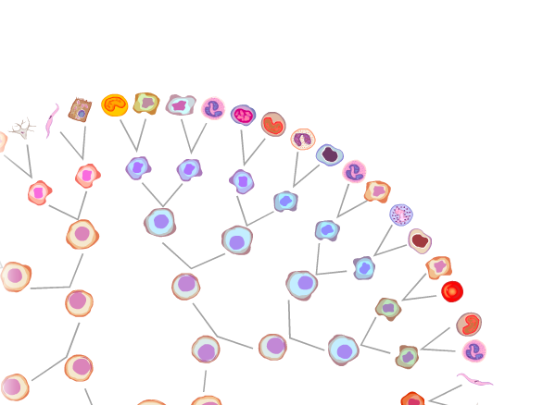
Stem Cells retain the capacity to divide and can differentiate along divergent pathways.
Screenshot from this excellent tutorial: http://www.ns.umich.edu/stemcells/022706_Intro.html

Slide 14
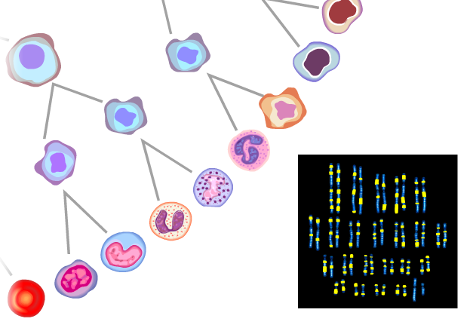
Differentiation (specialization) of cells:
All diploid (body) cells have the same chromosomes.
So they carry all the same genes and alleles. BUT
Not all genes are expressed (activated) in all cells.
The cell receives a signal.
This signal activates or deactivates genes.
Genes are expressed accordingly and the cell is committed.
Eventually the cell has become specialized to a function.
Key Concept: Structure vs Function
How do the structures of specialized cells reflect their functions? How does differentiation lead to this?
Screenshot from this excellent tutorial: http://www.ns.umich.edu/stemcells/022706_Intro.html

Slide 15
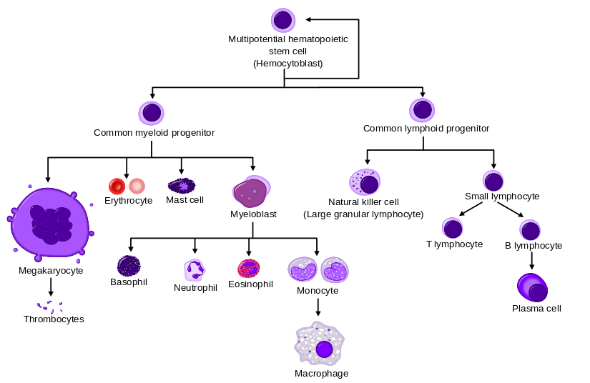
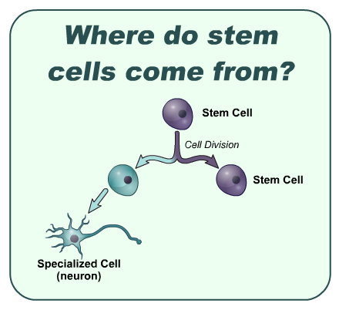
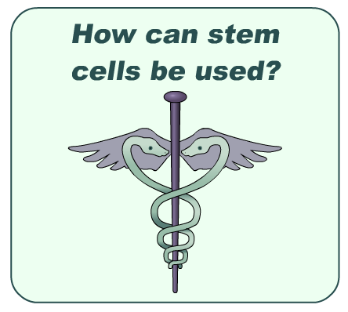
Therapeutic Uses of Stem Cells
Treatment for Leukemia
Problem | Cancer of the blood or bone marrow, resulting in abnormally high levels of poorly-functioning white blood cells.
Treatment | Chemotherapy and radiotherapy can be used to destroy the white blood cells, but these need to be replaced with healthy cells. Bone marrow transplants are often used for this.
Role of Stem Cells | Hematopoetic Stem Cells (HSCs) can be harvested from bone marrow, peripheral blood or umbilical cord blood. As these can differentiate to form any type of white blood cell, they can be used to repopulate the bone marrow and produce new, healthy blood cells. The use of a patient’s own HSCs means there is far less risk of immune rejection than with a traditional bone marrow transplant.
From:
http://en.wikipedia.org/wiki/Pluripotential_hemopoietic_stem_cell
Animation of this process:
Animated tutorials from: http://outreach.mcb.harvard.edu/animations/thera7c.swf

Slide 17
Use the news article to help you complete the following information:
Define the term stem cell.
2) Describe the role of stem cells in embryonic development.
3) There are potential non-therapeutic uses of stem cells. What do you think they might be?
What are main sources of stem cells?
What are the ethical concerns with stem cells?
Do you think we should continue research with embryonic stem cells?
List potential benefits of stem cell research
-
-
-
-
-
-
-
-
Key term | Definition
Differentiation
Therapeutic
Embryonic
Specialisation
Ethics

Slide 18
Plenary - Do you agree or disagree?
Destroying an embryo to get the stems cells is like murder. This should be a crime.
The government should pay for embryonic stem cell research. This could be our only hope for treatment of many injuries and diseases that cause suffering and death.
An early embryo that has not yet implanted into the uterus does not have the psychological, emotional or physical properties that we associate with being a person. It therefore does not have any interests to be protected and we can use it for the benefit of patients
The embryo cannot develop into a child without being transferred to a woman’s uterus. It needs external help to develop. Even then, the probability that embryos used for in vitro fertilization will develop into full-term successful births is low. Something that could potentially become a person should not be treated as if it actually were a person

Slide 19
Plenary - Do you agree or disagree?
More than half of all fertilized eggs are lost due to natural causes. If the natural process involves such loss, then using some embryos in stem cell research should not worry us either
Development from a fertilized egg into to baby is a continuous process and any attempt to pinpoint when personhood begins is arbitrary. A human embryo is a human being in the embryonic stage, just as an infant is a human being in the infant stage.
Although an embryo does not currently have the characteristics of a person, it will become a person and should be given the respect and dignity of a person.

Slide 20
Homework – read pages 3-6 about microscopes
Read pages 12 – 15 about stem cells
Five Minute Essay
What is a stem cell?
How do stem cells differentiate into specialized cells?
Outline one therapeutic use of stem cells.
Describe the ethical dilemmas
faced using stem cells

